Slide 1
CMOS Latch-up
In CMOS circuits, the parasitic NPN and PNP bipolar junction transistors (BJT) form a thyristor or PNPN structure.
When the thyristor is triggered by noise/glitch, the BJTs become ON, and it leads to a formation of short circuit between the power and ground lines, known as CMOS latch-up.
Once the device is triggered, the current through the device continues to increase due to regenerative feedback action, then it cannot be stopped.
The only way to stop it is to switch the power supply.

Slide 2
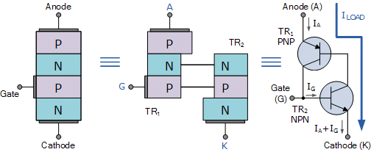
A thyristor
is a solid-state semiconductor device with four layers of alternating P- and N-type materials. It acts exclusively as a bistable switch,
conducting when the gate receives a current trigger, and continuing to conduct until the voltage across the device is reversed biased,
or until the voltage is removed.

Slide 3
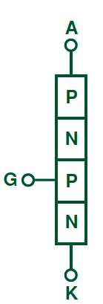
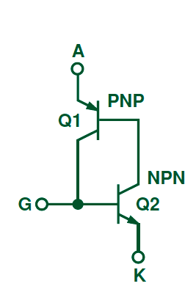
CMOS Latch-up
Background
•
The parasitic bipolar devices
device known as a Thyristor.
in
a
CMOS
chip
create
a
•
Thyristors are also known as
silicon‐controlled rectifiers
(SCR’s).
•
These devices have 4
alternating n and p layers.
Equivalent circuit

Slide 4
CMOS Latch-up
Latch‐up triggering mechanisms
•
An input or output voltage that is higher than the
supply voltage, VDD.
•
An electrostatic
discharge (ESD) event can trigger
a
thyristor due
involved.
to
the
high
voltages
and
currents
12

Slide 5
CMOS Latch-up
Latch‐up triggering mechanisms
•
While an ESD event has a very short duration, the
chip is flooded with charge carriers, which flow away
slowly, resulting in the triggering of the thyristor.
•
Caused by ionizing radiation found in:
–
–
–
The upper atmosphere or outer space
High energy sources in a lab environment
Nuclear power plants

Slide 6
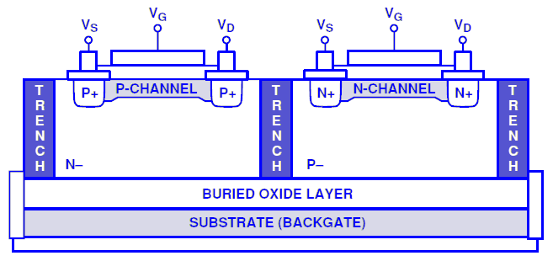
CMOS Latch-up
Latch‐up prevention
•
Stay below the absolute maximum ratings of the
chip.
•
Isolate the NMOS and PMOS devices using
an
oxide
trench
together
with
a
buried
oxide
layer:

Slide 7
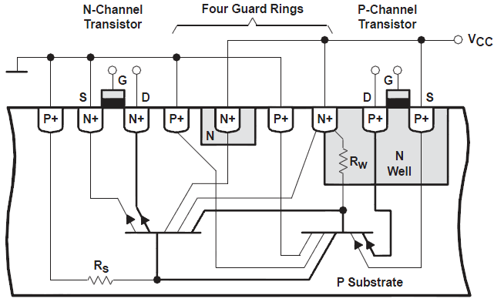
CMOS Latch-up
Latch‐up prevention
•
If you cannot include an oxide
trench,
then
use
guard
rings
around
your
devices:

Slide 8
CMOS Latch-up
Latch‐up prevention
The idea behind using a guard ring is:
to add more collector terminals
to the parasitic
transistors
in order to steer
the
current
flow
away
from
the
desired
devices.

Slide 9
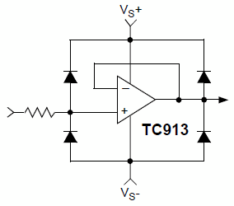
CMOS Latch-up
Latch‐up prevention
•
Use reverse biased diodes
input/output pins and the
between the
voltage
supplies.
•
Schottky diodes are preferred
because of
resistance.
their
low
forward

Slide 10
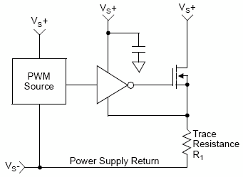
CMOS Latch-up
Latch‐up prevention
•
Improper grounding can cause latch‐up.
•
The PWM source outputs a low signal
which turns on the MOSFET.
to
the
inverter,
•
If the parasitic trace resistance (R1)
is large enough, the ground
of the inverter can be at a higher
potential than the input signal
which will cause latch‐up

Slide 11
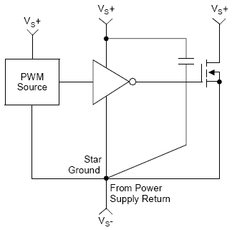
CMOS Latch-up
Latch‐up prevention
• Using proper grounding can avoid latch‐up
common ground point connections.
by
using
•
Using a common ground line is
effective because the parasitic
not
resistance in the ground
defeats the purpose.
line

Slide 12
Latch-up prevention techniques: System-level approaches
System-level approaches to avoid latch-up are as follows:
Power supplies must be off before plugging a board. A plug-in in power supply ON condition can cause a surge voltage to appear on the signal pins which could trigger the latch-up.
The electrostatic discharge (ESD) can trigger latch-up. ESD protection circuits need special care such that it does not lead to triggering of latch-up.
The electron–hole pairs are generated when radiation, such as X-rays, cosmic, or alpha-rays, penetrate into the chip. These carriers can contribute to well or substrate currents, leading to latch-up.
Simultaneous switching of a large number of transistors can cause noise in the power/ground lines, which can drive the circuit into latch-up. This must be checked through simulation.

Slide 13
Electrical Overstress and Electrostatic Discharge
Electrical overstress (EOS) is a failure mechanism of VLSI circuits where the device is subjected to excessive voltage, current, or power.
Electrostatic discharge (ESD) is the rapid transfer of large electrostatic charge into VLSI circuits through the I/O pads.
Both EOS and ESD are vulnerable for semiconductor devices, resulting in
damages in the device.
The mechanisms that damage the device are
Dielectric or oxide punch-through
Fusing of a conductor or resistor
Junction damage or burn-out

Slide 14
Electrical Overstress and Electrostatic Discharge
Electrostatic discharge occurs when a charged body releases its static charge to the ground in a very short span of time.
Typically, the ESD happens in a fraction of micro seconds.
In an IC chip, ESD happens in several ways. Some of them are as follows:
1. IC package pin is touched by human hands
2. IC package pin is held with metallic tweezers
3. IC package pin is in contact with the ground
The most commonly used ESD models are as follows:
Human body model (HBM)
Machine model (MM)
Charged-device model (CDM)

Slide 15
Soft Error in VLSI
A soft error is a noise or glitch that appears in a circuit generated from outside the chip.
It is caused by the charged particle striking the semiconductor devices.
These charged particles come from radioactive materials (alpha particles) and cosmic rays (protons and neutrons).
The physical phenomenon is often called soft error or soft error rate (SER), which only affects the memory elements by corrupting the stored data.

Slide 16
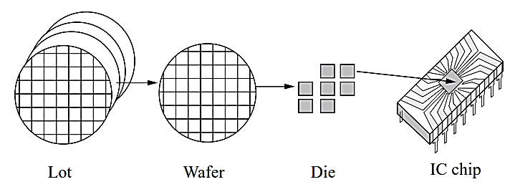
IC Packaging
The integrated circuits (ICs) are fabricated on a wafer in a batch.
The bunch of wafers, processed simultaneously, is called a lot.
From the processed wafer individual ICs called die are separated out by cutting the wafers.
A die is then packaged in a plastic or ceramic compound structure to form an IC chip.
The IC package is a cover to the internal core die which supports the die, and protects the die from damage.
A schematic of lot, wafer, die, and IC chip

Slide 17
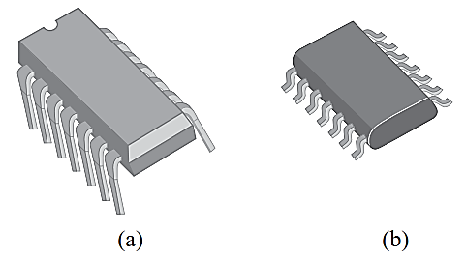
IC Packaging
Types of IC Packages
The IC packages are mainly classified into two types:
Pin-through-hole (PTH) package pins are extended in the vertical direction
so that they can be inserted through holes in the circuit board.
Surface-mount technology (SMT) package pins are extended in the horizontal direction so that they can be mounted on the surface of the circuit board.
A schematic of lot, wafer, die, and IC chip

Slide 18
Pin-through-hole Package
In the PTH package, the pins are inserted into holes in the printed circuit board (PCB) and soldered in place from the opposite side of the board.
It can also be inserted in the socket installed on the PCB.
The PTH packages can be classified based on the location of the pins as follows:
Single side
In the Single side package, they have pins over a single side. The pins can be positioned in-line or zig-zag. So, again depending on pin positions they are classified as
SIP (single in-line package)
ZIP (zig-zag in-line package)
Dual side
In the dual side package, the pins are located on both sides of the package in in-line pattern, hence the name DIP (dual in-line package).
Full surface package has pins located in arrays over the four
sides of the package. This type of package is called PGA (pin grid array).

Slide 19
Surface-mount Technology Package
The surface-mount technology (SMT) packages have pins that are soldered directly onto the surface of the circuit board. These packages do not require any hole in the circuit board.
SMT packages are preferred over PTH packages due to many of their advantages, such as SMT package can be mounted on both sides of the circuit board.
They are small in dimensions.
Their package parasites are reduced over PTH packages.
They increase circuit board wiring density.
Manufacturing is easier than PTH.

Slide 20
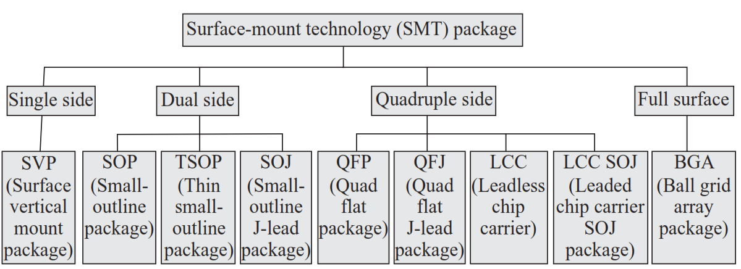
Surface-mount Technology Package
SMT packages are classified into several types based on the pin locations.

Slide 21
Packages Based on Package Material
Depending on the material used for packaging, the packages are classified into the following two types:
Plastic package
Inexpensive
High thermal resistance
Absorb Moisture
Prone to failure
Only used for low-cost applications
Ceramic package
No lead frame
Metal leads are directly soldered on the package
Leads are separated by ceramic layers
Expensive
Used for high-cost applications

Slide 22
IC Packaging Model
Some industry standard IC Packaging Model
Electrical Package Modelling
Electrical Equivalent Model
Thermal Modelling
Stress Modelling

Slide 23
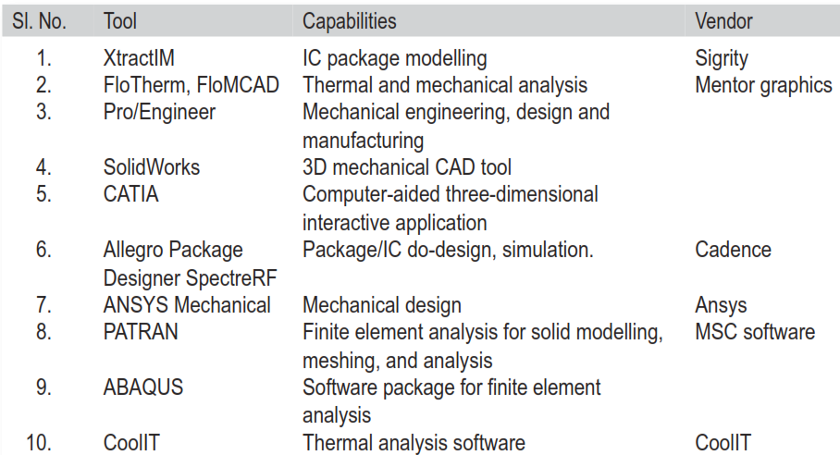
IC Packaging Model
Some of the widely used software for IC package design

Slide 24
VLSI testing
VLSI testing means checking of the manufactured IC to verify its correctness. If test results are satisfactory, then only the chip is qualified to be shipped to the customer.
Testing is done at several stages.
In the first stage, the die is tested at the wafer level. A test program is used to test the die. The test program applies a set of input bit patterns which are known as test vectors, and checks the test response. This test is often called the production test.
In the second stage, the die is separated out from the wafer and packaged, and it is again tested with the same test vectors. This is called the final test or package level test.

Slide 25
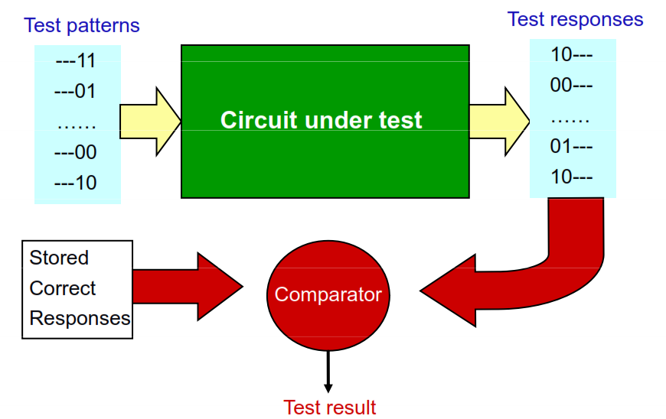
How to Test Chip

Slide 26
Defect, Fault, and Error
Defect
A defect is the unintended difference between the implemented hardware and its intended design. variance between expected results and actual results of execution of test case on the system.
Defects occur either during manufacture or during the use of devices.
Fault
A representation of a defect at the abstracted function level.
An incorrect step, process or data definition in a computer program which causes the program to perform in an unintended or unanticipated manner.
Error
A wrong output signal produced by a defective system.
An error is caused by a Fault or incorrect design.

Slide 27
Testing Techniques
Types of Testing Circuits
○ Combinational Circuit Testing
 Fault Model
 Path Sensitizing
 Random Test
○ Sequential Circuit
 Scan Path Test
Testing
 Built-in Self Test (BIST)
○ Built-in Logic Block Observer (BIBLO)
○ Signature Analyzer
 Boundary Scan Test (BST)
4

Slide 28
Design for Manufacturability (DFM)
A design must be manufacturable. The circuit or the layout should be designed so that yield of the manufactured chip is high.
There are different levels at which the design can be optimized to increase the manufacturability
Optimizing Physical Layout
Minimizing Power Dissipation
Wide Process Modelling
Yield Analysis
Bathtub curve
Cost Analysis

Slide 29

IC Reliability
Reliability of an IC chip defines how long the chip can operate without any performance degradation in the field.
The reliability of an IC can be defined as the probability that the chip will function according to its specifications for a period of time.
The reliability of a VLSI circuit is measured in terms of mean time to failure (MTTF).
If the failures are assumed to occur at a constant rate, the failure rate can be written as

Slide 30
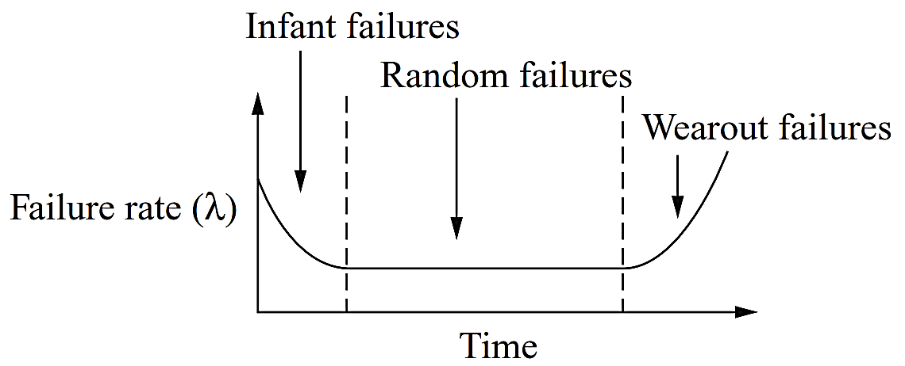
IC Reliability: bathtub curve
Failure rate, if plotted with respect to the operating lifetime of the device, shows a decreasing, then constant, and finally increasing nature.
This curve is known as the reliability bathtub curve.
Typical time dependence of system failure rate (bathtub curve)

Slide 31
Bathtub curve analysis
The first part is a decreasing failure rate, known as early failures.
The second part is a constant failure rate, known as random failures.
The third part is an increasing failure rate, known as wear-out failures.
The constant part of the bathtub curve signifies failures due to accidental over stress or overloads, occurring randomly over the operating lifetime of the product. This part of the curve is known as random failures.
The constant failure rates are mainly due to the external factors.
In the end, the devices wear out. This is called ageing effect, and due to this, the failure rate starts increasing exponentially.

Slide 32
Reliability Issues in ICs
The IC product lifetime is determined by several reliability mechanisms.
Some of the most important mechanisms are as follows:
Electromigration (EM)
Time-dependent dielectric breakdown (TDDB)
Channel-hot-electron (CHE)
Negative-bias temperature instability (NBTI)
Electrostatic discharge (ESD)
CMOS latch-up

Slide 33
Some Terminologies
Mean Time Between Failures (MTBF)
MTBF is used to measure the reliability for a repairable product.
Mean Time to Failure (MTTF)
MTTF is used to measure the reliability for a fatal failure.
Failure in Time (FIT)
FIT is used to measure the reliability for VLSI chips. 1 FIT indicates one device failure in 10⁹ device-hours.
The total failure rate of a product is calculated by summing up the FIT rates of the individual components of the chip.
For example, let us consider a product with the following components:
Microprocessor — 5 FIT
10 RAM chips — 6 FIT each
100 TTL parts — 1 FIT each
The total failure rate of the product is 5 + 10 × 6 + 100 × 1 = 165 FIT.

